Slide 1
EZ Sales Opportunity Report
By: Dharshika Singh

Slide 2
Project Objective
The objective of this project is to build a comprehensive Sales Pipeline Dashboard that helps stakeholders track and analyze sales opportunities, customer engagement stages, forecasted revenue, and overall sales performance. This interactive Power BI dashboard supports decision-making by highlighting key KPIs, conversion rates, churn rates, and product-wise insights across multiple dimensions.

Slide 3
Data Overview
The dataset comprises 971 rows representing various sales opportunities across different prospects, products, and stages in the sales cycle. Key columns include:
Prospect Name
Opportunity Name
Product
Current Stage
Opportunity Value
Forecast Period
Offering Type
These columns form the basis for our calculated KPIs and dashboard visualizations.

Slide 4
Data Cleaning & Preparation
Before visualizing the data, we cleaned and validated it:
Checked and corrected data types (e.g., date fields, numeric values)
Removed duplicate columns and null values
Standardized text entries (e.g., consistent naming for stages and products)

Slide 5
Feature Engineering
We created several calculated columns and measures to enhance analysis:
Total Opportunity Value
Opportunity Rank (based on total value)
Opportunity Group (e.g., Top N groups)
Win Rate % = (Number of Won Deals / Total Opportunities)
Churn Rate % = (Lost Deals / Total Opportunities)
Forecasted Revenue by Period

Slide 6
Dashboard Page 1
Title: Sales Pipeline Overview
Charts and Visuals:
Slicer: Prospect Name, Opportunity Name
Waterfall Chart: Total Opportunity Value by Product
Bar Chart: Opportunity Count by Current Stage
Column Chart: Revenue Forecast by Period
Table: Opportunity Group with Value Breakdow
Note: This page provides a complete overview of the sales pipeline with KPIs and key metrics. It allows filtering by specific prospects or opportunities to drill down into performance. The waterfall chart helps identify top-performing products. The funnel chart highlights the sales stages with the highest drop-offs.

Slide 7
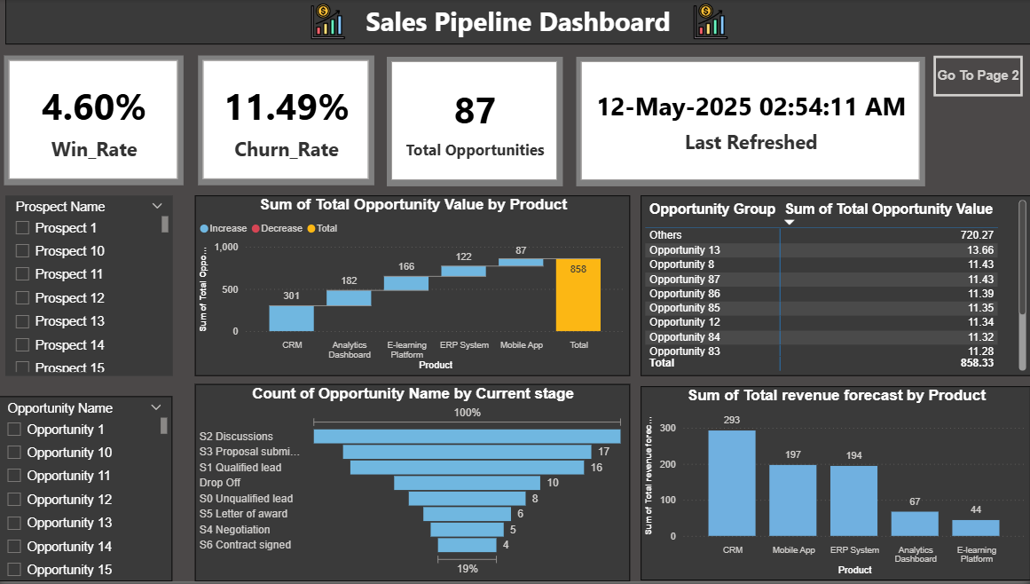

Slide 8
Dashboard Page 2
Title: Product & Offering Insights
Charts and Visuals:
Stacked Bar Chart: Opportunity by Stage & Product
Donut Chart: Product Share by Total Value
Matrix Table: Offering with Product, Services, and Solutions Breakdown
Note: This page dives deeper into product-wise and offering-level analysis. It shows how different solutions contribute to the pipeline and where most opportunities lie. The visual segmentation of opportunity stages helps identify where to focus to improve conversion.

Slide 9
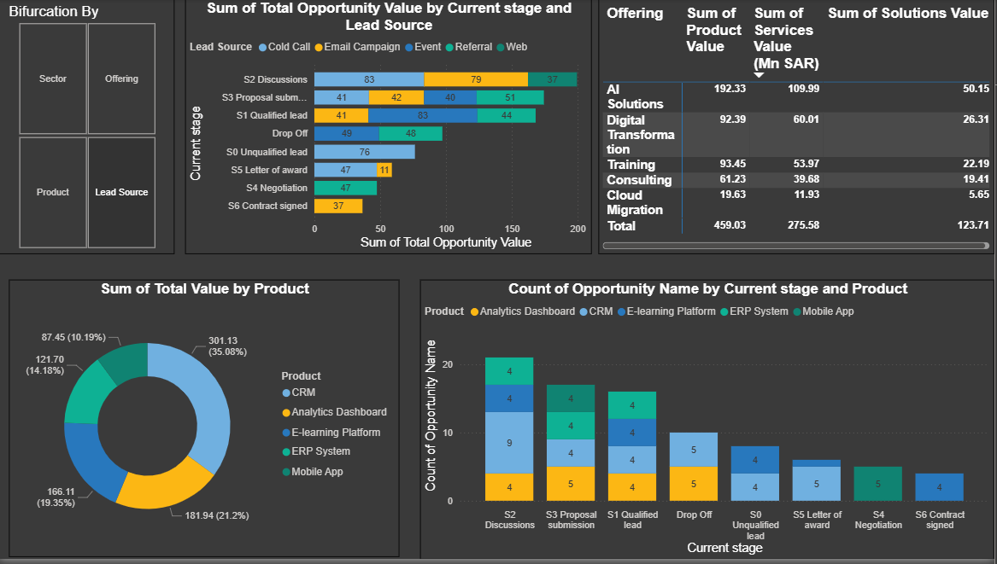

Slide 10
Conclusion
The Sales Pipeline Dashboard successfully transforms raw sales data into a strategic decision-making tool. By providing real-time insights into opportunity stages, product performance, and forecasted revenue, the dashboard supports sales leadership in tracking pipeline health and optimizing conversion strategies.
This project not only delivers a scalable and data-driven solution but also lays the foundation for future enhancements like predictive analytics and opportunity scoring. Ultimately, it serves as a crucial asset in driving sales growth, enhancing customer focus, and aligning efforts across business functions.

